Slide 1
VLAN & VTP
Course Code: CSC 3116
Course Title: Computer Networks
Dept. of Computer Science
Faculty of Science and Technology
Lecturer No: | 7 | Week No: | 7 | Semester: | Summer 19_20
Lecturer: | Shahrin Chowdhury, shahrin@aiub.edu

Slide 2
Lecture Outline
1. What is VLAN
2. Advantages of VLAN
3. Trunk Port
4. Router on stick
5. What is VTP
6. VTP Benefits
7. VTP Modes of Operation

Slide 3
Virtual LANs (VLANs)
Flat Network
A flat network is designed to reduce cost, maintenance and administration. It reduces the number of routers and switches on the network. Instead of connecting to separate switches it encourages to use a single switch. It avoids the hierarchical design. Flat network is not segmented or separated into different broadcast areas by using routers. For connecting devices instead of using switches and routers it uses hub and switches.

Slide 4
Virtual LANs (VLANs)
Problems of Flat network:
Single broadcast domain
Slow down network performance
Security issue
A VLAN acts like a physical LAN, but it allows hosts to be grouped together in the same broadcast domain even if they are not connected to the same switch.
VLANs allow you to break up switched environments into multiple broadcast domains. Here is the basic summary of a VLAN:
A VLAN = A Broadcast Domain = An IP Subnet

Slide 5
Advantages of VLAN
Performance
Security
Cost
Location
Management

Slide 6
Advantages of VLAN (cont…)
Performance:
A single switch without vlan has got one broadcast domain. If the number of switches adds to that network the broadcast domain will become bigger but it will not split up. More devices make the traffic intense. With the problem in a single port of any switch it will create disturbance in the whole network, as the switches have same broadcast domain. This decreases the network performance. On the other hand, Vlan split-ups broadcast domain. One vlan means one broadcast domain. It will definitely help to improve network performance.

Slide 7
Advantages of VLAN (cont…)
Security:
Vlan enhances security by dividing a large domain in small collision domains. A malicious user can’t get connected very easily in a vlan because it is more manageable for the system admin, as it will have a limited switch ports.
Cost:
Router helps to differentiate between the networks but router is expensive. Vlan helps to
decrease the dependency on router to some extent. It helps to create virtual local area, which definitely reduce the cost.

Slide 8
Advantages of VLAN (cont…)
Location:
It has got ability to add wanted users to a vlan regardless of their physical location.
Management:
A single port configuration can assign a new student or a new employee in vlan. It is easily manageable.
There are two types of VLAN connection links:
Access link
Trunk link

Slide 9
Trunk Port
Connection between the switches must carry traffic for multiple VLANs. This type of port is known as a trunk port. Trunk ports are often called tagged ports because the switches send frames between each other with a VLAN "tag" in place. Trunk ports are often called tagged ports because the switches send frames between each other with a VLAN "tag" in place.
VLANs are not a Cisco-only technology. Just about all managed switch vendors support VLANs. In order for VLANs to operate in a mixed-vendor environment, a common trunking or "tagging" language must exist between them. This language is known as 802.1Q (Industry standard). All vendors design their switches to recognize and understand the 802.1Q tag, which is what allows us to trunk between switches in any environment.

Slide 10
Trunk Port (cont…)
IEEE 802.1Q uses an internal tagging mechanism. The trunking device inserts a 4-byte tag in order to identify the VLAN to which a frame belongs and then recomputes the frame check sequence (FCS).

Slide 11
Trunking
VLANs are local to each switch's database, and VLAN information is not passed between switches.
Trunk links provide VLAN identification for frames traveling between switches.
Cisco switches have two Ethernet trunking mechanisms: ISL and IEEE 802.1Q.
Certain types of switches can negotiate trunk links.
Trunks carry traffic from all VLANs to and from the switch by default but can be configured to carry only specified VLAN traffic.
Trunk links must be configured to allow trunking on each end of the link.
Purpose:
For managing all configured VLANs across a switch internetwork & maintain consistency
Allows an administrator to add, delete, & rename VLANs

Slide 12
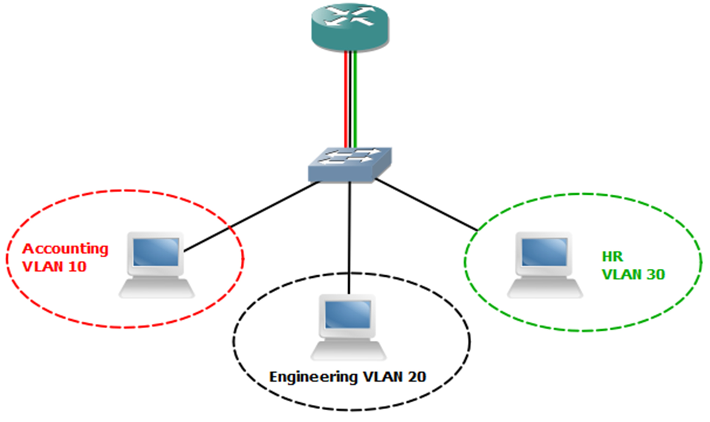
Router on stick
Router-on-a-stick is a type of router configuration in which a single physical interface manages traffic between multiple VLANs on a network. The router receives VLAN tagged traffic on the
trunk interface from the nearby switch (SW1), and forwards the routed traffic out to VLAN tagged destination using the same interface
F0/0
F0/0.10
F0/0.20
F0/0.30
F0/0.10-10.0.0.1/26, f0/0.20-10.0.0.65/27, f0/0.30-10.0.0.97/28
Acc-10.0.0.0/26(1-62), Engg- 10.0.0.64/27 (65-94), Hr- 10.0.0.96/28 (97-106)
Traditional Inter-VLAN Routing
The router has one physical port for each VLAN.
Each port has an IP address on its own VLAN.
Routing is the same as routing between any subnets.
10.0.0.0/20
Acc-50, Engg -25, Hr-10
F0/2-f0/51, f0/52-f0/76, f0/77-f0/86

Slide 13
VTP Modes of Operation
Server
create, modify, and delete VLANs
VTP version and VTP pruning, for the entire VTP domain links
VTP server is the default mode.
Client
Cannot create, change, or delete VLANs on a VTP client.
Receives information + sends/receives updates

Slide 14
VTP Modes of Operation (cont…)
Transparent
VTP transparent switches do not participate in VTP.
A VTP transparent switch does not advertise its VLAN configuration
Receives information + sends/receives updates
Transparent switches do forward VTP advertisements that they receive out their trunk ports in VTP Version 2.

Slide 15
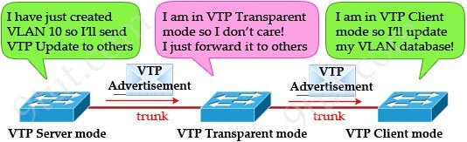
VTP Modes of Operation (cont…)

Slide 16
References
Data Communications and Networking, B. A. Forouzan, McGraw-Hill, Inc., Fourth Edition, 2007, USA.
https://www.geeksforgeeks.org/basics-computer-networking/
https://www.tutorialspoint.com/computer_fundamentals/computer_networking.htm

Slide 17
Books
Data Communications and Networking, B. A. Forouzan, McGraw-Hill, Inc., Fourth Edition, 2007, USA.
Computer Networking: A Top-Down Approach, J. F., Kurose, K. W. Ross, Pearson Education, Inc., Sixth Edition, USA.
Official Cert Guide CCNA 200-301 , vol. 1, W. Odom, Cisco Press, First Edition, 2019, USA.
CCNA Routing and Switching, T. Lammle, John Wily & Sons, Second Edition, 2016, USA.
TCP/IP Protocol Suite, B. A. Forouzan, McGraw-Hill, Inc., Fourth Edition, 2009, USA.
Data and Computer Communication, W. Stallings, Pearson Education, Inc., 10th Education, 2013, USA.

